Slide 1

PARALLEL PROGRAMMING...
Copyright 2023 Patrick Lemoine. All rights reserved.

Slide 2

Parallel Computing Using CUDA
SESSION 4/6
GOAL
Programming Interface for parallel computing With CUDA
What is CUDA ?
Concepts
Running in parallel (Blocks)
Introduction Threads
Combining Threads & Blocks (Indexing)
Cooperating Threads (Shared memory)
Managing the device (Asynchronous operation)
API Examples

Slide 3



What is CUDA ?

Slide 4

What is CUDA ?
A proprietary platform developed by Nvidia that allows programmers to write C/C++ code that runs directly on Nvidia GPUs.
It also provides libraries and tools for various domains such as linear algebra, image processing, deep learning, etc.
CUDA Architecture
Expose GPU parallelism for general-purpose computing
Retain performance
CUDA C/C++
Based on industry-standard C/C++
Small set of extensions to enable heterogeneous programming
Straightforward APIs to manage devices, memory etc.

Slide 5
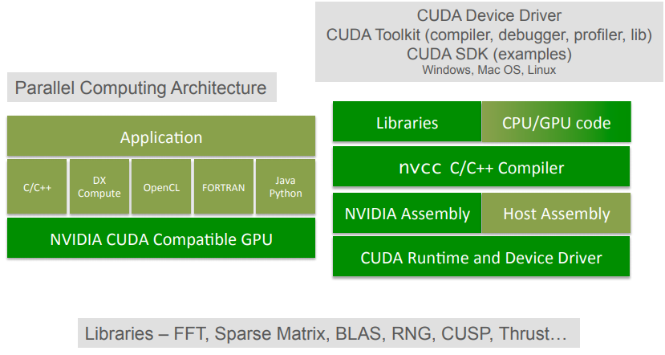
CUDA

Slide 6

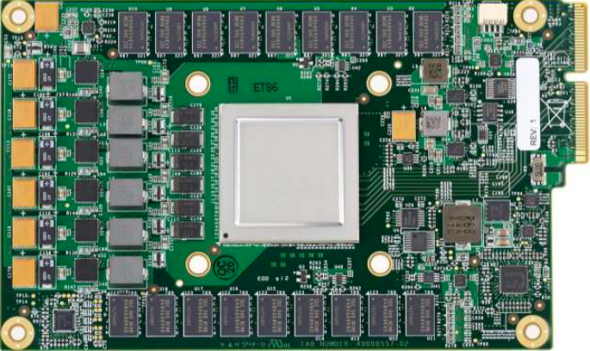
GPU (Graphics Processing Unit)
A GPU is uses to speed up the process of creating and rendering computer graphics, designed to accelerate graphics and image processing.
It is the most important hardware.
But have later been used for non-graphic calculations involving embarrassingly parallel problems due to their parallel structure.

Slide 7
What is GPGPU ?
General Purpose computation using GPU in applications other than 3D graphics
GPU accelerates critical path of application
Data parallel algorithms leverage GPU attributes
Large data arrays, streaming throughput
Fine-grain SIMD parallelism
Low-latency floating point (FP) computation
Applications – see //GPGPU.org
Game effects (FX) physics, image processing
Physical modeling, computational engineering, matrix algebra, convolution, correlation, sorting
Notes:
<number>
Mark Harris, of Nvidia, runs the gpgpu.org website

Slide 8
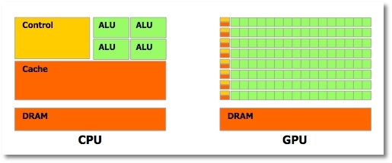
CUDA: Goals
Scale code to hundreds of cores running thousands of threads
The task runs on the GPU independently from the CPU

Slide 9
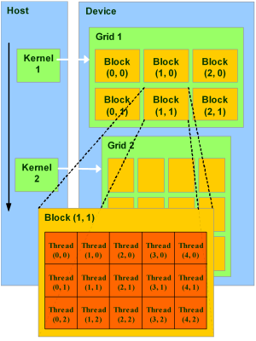
CUDA: Structure
Threads are grouped into thread blocks
Blocks are grouped into a single grid
The grid is executed on the GPU as a kernel

Slide 10
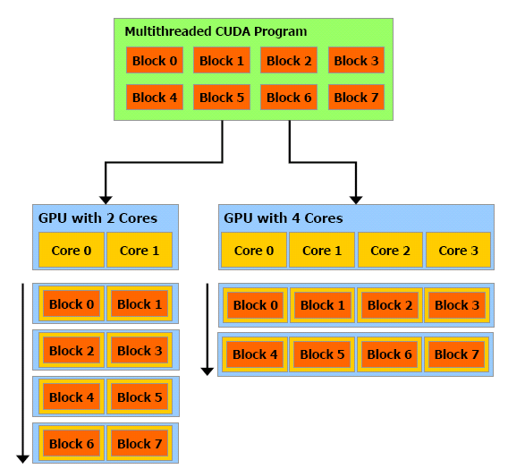
CUDA: Scalability
Blocks map to cores on the GPU
Allows for portability when changing hardware

Slide 11
CUDA: Memory Tranfer
cudaMemcpy( void *dst, void *src, size_t nbytes, enum cudaMemcpyKind direction);
returns after the copy is complete blocks CPU
thread doesn’t start copying until previous CUDA calls complete
enum cudaMemcpyKind
cudaMemcpyHostToDevice
cudaMemcpyDeviceToHost
cudaMemcpyDeviceToDevice

Slide 12
CUDA: Host Synchronization
All kernel launches are asynchronous
control returns to CPU immediately
kernel starts executing once all previous CUDA calls have completed
Memcopies are synchronous
control returns to CPU once the copy is complete
copy starts once all previous CUDA calls have completed
cudaThreadSynchronize()
blocks until all previous CUDA calls complete
Asynchronous CUDA calls provide:
non-blocking memcopies
ability to overlap memcopies and kernel execution

Slide 13
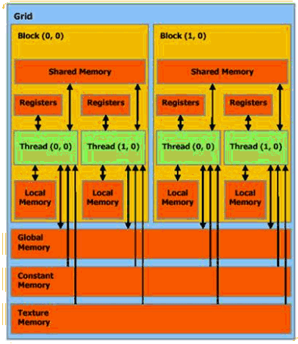
CUDA: Memory Hierarchy
Shared memory much much faster than global
Don’t trust local memory
Global, Constant, and Texture memory available to both host and cpu

Slide 14
CUDA: Global and Shared Memory
Global memory not cached on G8x GPUs
High latency, but launching more threads hides latency
Important to minimize accesses
Coalesce global memory accesses (more later)
Shared memory is on-chip, very high bandwidth
Low latency (100-150times faster than global memory)
Like a user-managed per-multiprocessor cache
Try to minimize or avoid bank conflicts (more later)

Slide 15
CUDA: Texture and Constant Memory
Texture partition is cached
Uses the texture cache also used for graphics
Optimized for 2D spatial locality
Best performance when threads of a warp read locations that are close together in 2D
Constant memory is cached
4 cycles per address read within a single warp
Total cost 4 cycles if all threads in a warp read same address
Total cost 64 cycles if all threads read different addresses

Slide 16
CUDA: Coalescing
A coordinated read by a half-warp (16threads)
A contiguous region of global memory:
64bytes - each thread reads a word: int, float, …
128bytes - each thread reads a double-word: int2, float2, …
256bytes - each thread reads a quad-word: int4, float4, …
Additional restrictions:
Starting address for a region must be a multiple of region size
The kth thread in a half-warp must access the kth element in a block being read
Exception: not all threads must be participating
Predicated access, divergence within a halfwarp

Slide 17
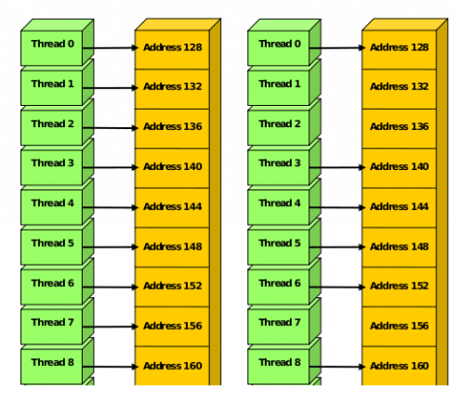
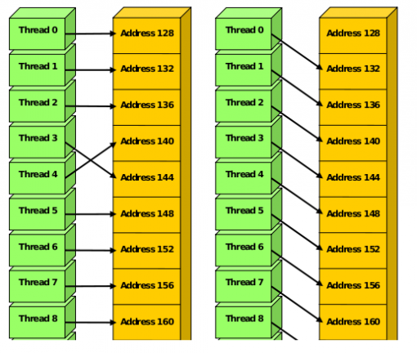
CUDA: Coalescing
Coalesced memory accesses
Uncoalesced memory accesses

Slide 18
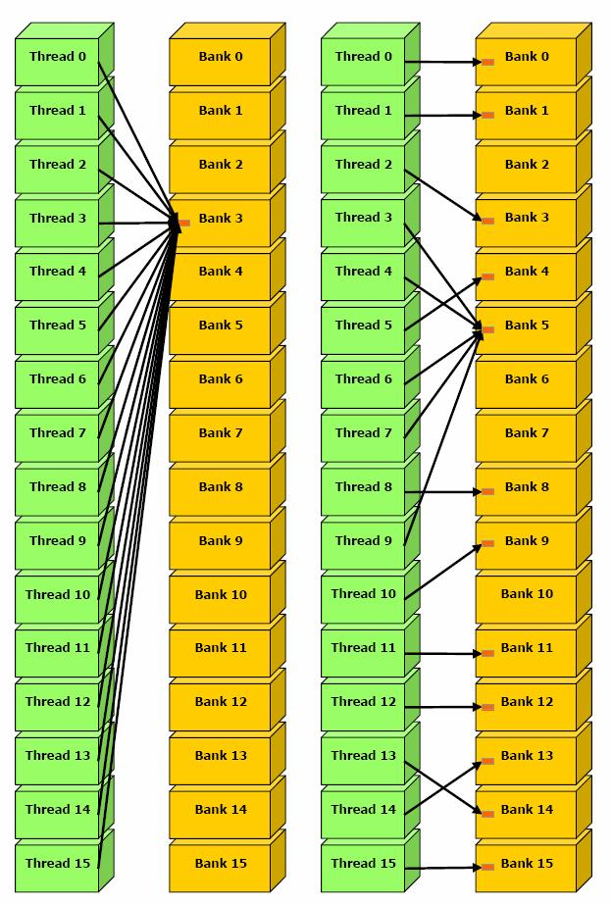
CUDA: Bank Conflicts
Shared memory is divided into banks
Each bank has serial read/write access
Bank addresses are striped
If more than one thread attempts to access the same bank at the same time, they’re accesses are serialized
This is a bank conflict

Slide 19
CUDA Concepts

Slide 20

Heterogeneous Computing
Blocks
Threads
CUDA CONCEPTS
Indexing
Shared memory
__syncthreads()
Asynchronous operation
Handling errors
Managing devices

Slide 21

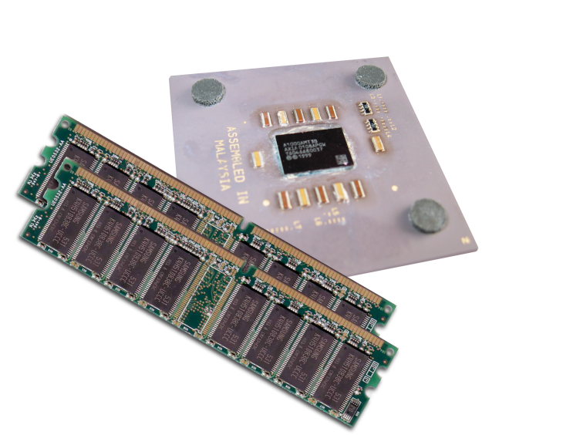
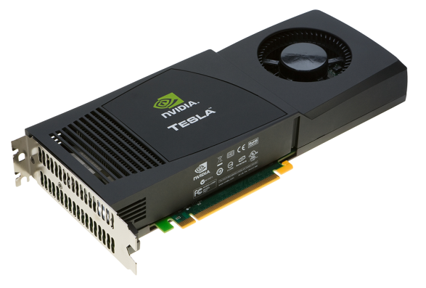
CUDA: Heterogeneous Computing
Terminology:
Host The CPU and its memory (host memory)
Device The GPU and its memory (device memory)
Host
Device

Slide 22
#include <iostream>
#include <algorithm>
using namespace std;
#define N 1024
#define RADIUS 3
#define BLOCK_SIZE 16
__global__ void stencil_1d(int *in, int *out) {
__shared__ int temp[BLOCK_SIZE + 2 * RADIUS];
int gindex = threadIdx.x + blockIdx.x * blockDim.x;
int lindex = threadIdx.x + RADIUS;
// Read input elements into shared memory
temp[lindex] = in[gindex];
if (threadIdx.x < RADIUS) {
temp[lindex - RADIUS] = in[gindex - RADIUS];
temp[lindex + BLOCK_SIZE] = in[gindex + BLOCK_SIZE];
}
// Synchronize (ensure all the data is available)
__syncthreads();
// Apply the stencil
int result = 0;
for (int offset = -RADIUS ; offset <= RADIUS ; offset++)
result += temp[lindex + offset];
// Store the result
out[gindex] = result;
}
void fill_ints(int *x, int n) {
fill_n(x, n, 1);
}
int main(void) {
int *in, *out; // host copies of a, b, c
int *d_in, *d_out; // device copies of a, b, c
int size = (N + 2*RADIUS) * sizeof(int);
// Alloc space for host copies and setup values
in = (int *)malloc(size); fill_ints(in, N + 2*RADIUS);
out = (int *)malloc(size); fill_ints(out, N + 2*RADIUS);
// Alloc space for device copies
cudaMalloc((void **)&d_in, size);
cudaMalloc((void **)&d_out, size);
// Copy to device
cudaMemcpy(d_in, in, size, cudaMemcpyHostToDevice);
cudaMemcpy(d_out, out, size, cudaMemcpyHostToDevice);
// Launch stencil_1d() kernel on GPU
stencil_1d<<<N/BLOCK_SIZE,BLOCK_SIZE>>>(d_in + RADIUS, d_out + RADIUS);
// Copy result back to host
cudaMemcpy(out, d_out, size, cudaMemcpyDeviceToHost);
// Cleanup
free(in); free(out);
cudaFree(d_in); cudaFree(d_out);
return 0;
}
parallel fn
serial code
parallel code
serial code

Slide 23
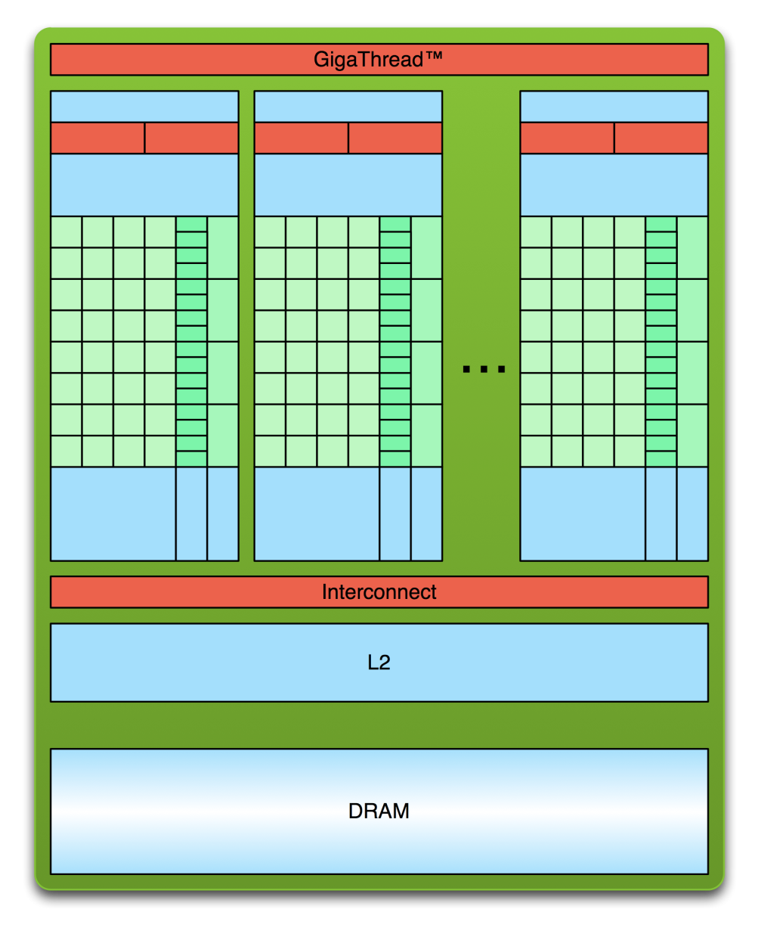
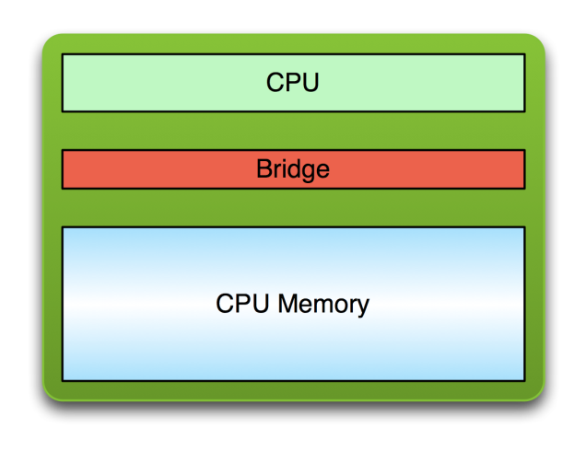
CUDA: Simple Processing Flow
PCI Bus
Copy input data from CPU memory to GPU memory

Slide 24
CUDA: Simple Processing Flow
PCI Bus
Copy input data from CPU memory to GPU memory
Load GPU program and execute, caching data on chip for performance

Slide 25
CUDA: Simple Processing Flow
PCI Bus
Copy input data from CPU memory to GPU memory
Load GPU program and execute, caching data on chip for performance
Copy results from GPU memory to CPU memory

Slide 26

CUDA: Program
__global__ void mykernel(void) {}
CUDA C/C++ keyword __global__ indicates a function that:
Runs on the device
Is called from host code
nvcc separates source code into host and device components
Device functions (e.g. mykernel()) processed by NVIDIA compiler
Host functions (e.g. main()) processed by standard host compiler
gcc, cl.exe
With device COde
mykernel<<<1,1>>>();
Triple angle brackets mark a call from host code to device code
Also called a “kernel launch”
We’ll return to the parameters (1,1) in a moment
That’s all that is required to execute a function on the GPU!

Slide 27
CUDA: Program
__global__ void mykernel(void){}
int main(void) {
mykernel<<<1,1>>>();
printf("Hello World!\n");
return 0;
}
Output:
$ nvcc hello.cu
$ a.out
Hello World!
$

Slide 28
CUDA: Memory Management
Host and device memory are separate entities
Device pointers point to GPU memory
May be passed to/from host code
May not be dereferenced in host code
Host pointers point to CPU memory
May be passed to/from device code
May not be dereferenced in device code
Simple CUDA API for handling device memory
cudaMalloc(), cudaFree(), cudaMemcpy()
Similar to the C equivalents malloc(), free(), memcpy()

Slide 29
CUDA: Addition on the Device
__global__ void add(int *a, int *b, int *c)
{
*c = *a + *b;
}
// Copy inputs to device
cudaMemcpy(d_a, &a, size, cudaMemcpyHostToDevice);
cudaMemcpy(d_b, &b, size, cudaMemcpyHostToDevice);
// Launch add() kernel on GPU
add<<<1,1>>>(d_a, d_b, d_c);
// Copy result back to host
cudaMemcpy(&c, d_c, size, cudaMemcpyDeviceToHost);
// Cleanup
cudaFree(d_a); cudaFree(d_b); cudaFree(d_c);
return 0;
}
int main(void) {
int a, b, c; // host copies of a, b, c
int *d_a, *d_b, *d_c; // device copies of a, b, c
int size = sizeof(int);
// Allocate space for device copies of a, b, c
cudaMalloc((void **)&d_a, size);
cudaMalloc((void **)&d_b, size);
cudaMalloc((void **)&d_c, size);
// Setup input values
A = 2; b = 7;

Slide 30
CONCEPTS
Heterogeneous Computing
Blocks
Threads
Indexing
Shared memory
__syncthreads()
Asynchronous operation
Handling errors
Running in Parallel
Managing devices

Slide 31
CUDA: Moving to Parallel
GPU computing is about massive parallelism
So how do we run code in parallel on the device?
add<<< 1, 1 >>>();
add<<< N, 1 >>>();
Instead of executing add() once, execute N times in parallel

Slide 32
CUDA: Vector Addition on the Device
With add() running in parallel we can do vector addition
Terminology: each parallel invocation of add() is referred to as a block
The set of blocks is referred to as a grid
Each invocation can refer to its block index using blockIdx.x
__global__ void add(int *a, int *b, int *c)
{
c[blockIdx.x] = a[blockIdx.x] + b[blockIdx.x];
}
By using blockIdx.x to index into the array, each block handles a different index
On the device, each block can execute in parallel:
Block 0
Block 1
Block 2
Block 3
c[0] = a[0] + b[0];
c[1] = a[1] + b[1];
c[2] = a[2] + b[2];
c[3] = a[3] + b[3];

Slide 33
CUDA: Vector Addition on the Device
#define N 512
int main(void) {
int *a, *b, *c; // host copies of a, b, c
int *d_a, *d_b, *d_c; // device copies of a, b, c
int size = N * sizeof(int);
// Alloc space for device copies of a, b, c
cudaMalloc((void **)&d_a, size);
cudaMalloc((void **)&d_b, size);
cudaMalloc((void **)&d_c, size);
// Alloc space for host copies of a, b, c
// and setup input values
a = (int *)malloc(size); random_ints(a, N);
b = (int *)malloc(size); random_ints(b, N);
c = (int *)malloc(size);
// Copy inputs to device
cudaMemcpy(d_a, a, size, cudaMemcpyHostToDevice);
cudaMemcpy(d_b, b, size, cudaMemcpyHostToDevice);
// Launch add() kernel on GPU with N blocks
add<<<N,1>>>(d_a, d_b, d_c);
// Copy result back to host
cudaMemcpy(c, d_c, size, cudaMemcpyDeviceToHost);
// Cleanup
free(a); free(b); free(c);
cudaFree(d_a); cudaFree(d_b); cudaFree(d_c);
return 0;
}

Slide 34
CUDA: Review
Difference between host and device
Host CPU
Device GPU
Using __global__ to declare a function as device code
Executes on the device
Called from the host
Passing parameters from host code to a device function
Basic device memory management
cudaMalloc()
cudaMemcpy()
cudaFree()
Launching parallel kernels
Launch N copies of add() with add<<<N,1>>>(…);
Use blockIdx.x to access block index

Slide 35
CONCEPTS
Heterogeneous Computing
Blocks
Threads
Indexing
Shared memory
__syncthreads()
Asynchronous operation
Introducing Threads
Handling errors
Managing devices

Slide 36
CUDA: Threads
Terminology: a block can be split into parallel threads
Let’s change add() to use parallel threads instead of parallel blocks
__global__ void add(int *a, int *b, int *c) {
c[threadIdx.x] = a[threadIdx.x] + b[threadIdx.x];
}
We use threadIdx.x instead of blockIdx.x
Need to make one change in main()…

Slide 37
CUDA: Vector Addition Using Thread
#define N 512
int main(void) {
int *a, *b, *c; // host copies of a, b, c
int *d_a, *d_b, *d_c; // device copies of a, b, c
int size = N * sizeof(int);
// Alloc space for device copies of a, b, c
cudaMalloc((void **)&d_a, size);
cudaMalloc((void **)&d_b, size);
cudaMalloc((void **)&d_c, size);
// Alloc space for host copies of a, b, c and setup input values
a = (int *)malloc(size); random_ints(a, N);
b = (int *)malloc(size); random_ints(b, N);
c = (int *)malloc(size);
// Copy inputs to device
cudaMemcpy(d_a, a, size, cudaMemcpyHostToDevice);
cudaMemcpy(d_b, b, size, cudaMemcpyHostToDevice);
// Launch add() kernel on GPU with N threads
add<<<1,N>>>(d_a, d_b, d_c);
// Copy result back to host
cudaMemcpy(c, d_c, size, cudaMemcpyDeviceToHost);
// Cleanup
free(a); free(b); free(c);
cudaFree(d_a); cudaFree(d_b); cudaFree(d_c);
return 0;
}

Slide 38
CONCEPTS
Heterogeneous Computing
Blocks
Threads
Indexing
Shared memory
__syncthreads()
Asynchronous operation
Handling errors
Combining Threads And Blocks
Managing devices

Slide 39
CUDA: Combining Blocks and Threads
We’ve seen parallel vector addition using:
Many blocks with one thread each
One block with many threads
Let’s adapt vector addition to use both blocks and threads
Why? We’ll come to that…
First let’s discuss data indexing…

Slide 40
CUDA: Indexing Arrays with Blocks and Threads
No longer as simple as using blockIdx.x and threadIdx.x
Consider indexing an array with one element per thread (8 threads/block)
threadIdx.x
threadIdx.x
threadIdx.x
threadIdx.x
0
1
2
3
4
5
6
7
0
1
2
3
4
5
6
7
0
1
2
3
4
5
6
7
0
1
2
3
4
5
6
7
blockIdx.x = 0
blockIdx.x = 1
blockIdx.x = 2
blockIdx.x = 3
With M threads/block a unique index for each thread is given by:
int index = threadIdx.x + blockIdx.x * M;

Slide 41
CUDA: Indexing Arrays example
Which thread will operate on the red element?
0
1
2
3
4
5
6
7
8
9
10
11
12
13
14
15
16
17
18
19
20
21
22
23
24
25
26
27
28
29
30
31
M = 8
threadIdx.x = 5
0
1
2
3
4
5
6
7
0
1
2
3
4
5
6
7
0
1
2
3
4
5
6
7
0
1
2
3
4
5
6
7
blockIdx.x = 2
int index = threadIdx.x + blockIdx.x * M;
= 5 + 2 * 8;
= 21;

Slide 42
CUDA: Vector Addition with blocks and Threads
Use the built-in variable blockDim.x for threads per block
int index = threadIdx.x + blockIdx.x * blockDim.x;
Combined version of add() to use parallel threads and parallel blocks
__global__ void add(int *a, int *b, int *c) {
int index = threadIdx.x + blockIdx.x * blockDim.x;
c[index] = a[index] + b[index];
}
What changes need to be made in main()?

Slide 43
CUDA: Addition with Blocks and Threads
// Copy inputs to device
cudaMemcpy(d_a, a, size, cudaMemcpyHostToDevice);
cudaMemcpy(d_b, b, size, cudaMemcpyHostToDevice);
// Launch add() kernel on GPU
add<<<N/THREADS_PER_BLOCK,THREADS_PER_BLOCK>>>(d_a, d_b, d_c);
/ Copy result back to host
cudaMemcpy(c, d_c, size, cudaMemcpyDeviceToHost);
// Cleanup
free(a); free(b); free(c);
cudaFree(d_a); cudaFree(d_b); cudaFree(d_c);
return 0;
}
#define N (2048*2048)
#define THREADS_PER_BLOCK 512
int main(void) {
int *a, *b, *c; // host copies of a, b, c
int *d_a, *d_b, *d_c; // device copies of a, b, c
int size = N * sizeof(int);
// Alloc space for device copies of a, b, c
cudaMalloc((void **)&d_a, size);
cudaMalloc((void **)&d_b, size);
cudaMalloc((void **)&d_c, size);
// Alloc space for host copies of a, b, c and setup input values
a = (int *)malloc(size); random_ints(a, N);
b = (int *)malloc(size); random_ints(b, N);
c = (int *)malloc(size);

Slide 44
CUDA: Handling Arbitrary Vector Sizes
Typical problems are not friendly multiples of blockDim.x
Avoid accessing beyond the end of the arrays:
__global__ void add(int *a, int *b, int *c, int n) {
int index = threadIdx.x + blockIdx.x * blockDim.x;
if (index < n)
c[index] = a[index] + b[index];
}
Update the kernel launch:
add<<<(N + M-1) / M,M>>>(d_a, d_b, d_c, N);

Slide 45
CUDA
Launching parallel kernels
Launch N copies of add() with add<<<N/M,M>>>(…);
Use blockIdx.x to access block index
Use threadIdx.x to access thread index within block
Allocate elements to threads:
int index = threadIdx.x + blockIdx.x * blockDim.x;

Slide 46
CONCEPTS
Heterogeneous Computing
Blocks
Threads
Indexing
Shared memory
__syncthreads()
Asynchronous operation
Cooperating Threads
Handling errors
Managing devices

Slide 47
CUDA: 1D Stencil
Consider applying a 1D stencil to a 1D array of elements
Each output element is the sum of input elements within a radius
If radius is 3, then each output element is the sum of 7 input elements:
radius
radius
Implementing Within a Block
Each thread processes one output element
blockDim.x elements per block
Input elements are read several times
With radius 3, each input element is read seven times

Slide 48
CUDA: Sharing Data Between Threads
Terminology: within a block, threads share data via shared memory
Extremely fast on-chip memory, user-managed
Declare using __shared__, allocated per block
Data is not visible to threads in other blocks

Slide 49
CUDA: Implementing with Shared Memory
Cache data in shared memory
Read (blockDim.x + 2 * radius) input elements from global memory to shared memory
Compute blockDim.x output elements
Write blockDim.x output elements to global memory
Each block needs a halo of radius elements at each boundary
halo on left
halo on right
blockDim.x output elements

Slide 50
CUDA: Stencil Kernel
__global__ void stencil_1d(int *in, int *out) {
__shared__ int temp[BLOCK_SIZE + 2 * RADIUS];
int gindex = threadIdx.x + blockIdx.x * blockDim.x;
int lindex = threadIdx.x + RADIUS;
// Read input elements into shared memory
temp[lindex] = in[gindex];
if (threadIdx.x < RADIUS) {
temp[lindex - RADIUS] = in[gindex - RADIUS];
temp[lindex + BLOCK_SIZE] =
in[gindex + BLOCK_SIZE];
}

Slide 51
CUDA: Stencil Kernel
// Apply the stencil
int result = 0;
for (int offset = -RADIUS ; offset <= RADIUS ; offset++)
result += temp[lindex + offset];
// Store the result
out[gindex] = result;
}

Slide 52
CUDA: Data Race
The stencil example will not work…
Suppose thread 15 reads the halo before thread 0 has fetched it…
temp[lindex] = in[gindex];
if (threadIdx.x < RADIUS) {
temp[lindex – RADIUS = in[gindex – RADIUS];
temp[lindex + BLOCK_SIZE] = in[gindex + BLOCK_SIZE];
}
int result = 0;
result += temp[lindex + 1];
Store at temp[18]
Skipped, threadIdx > RADIUS
Load from temp[19]

Slide 53
CUDA: __syncthreads()
void __syncthreads();
Synchronizes all threads within a block
Used to prevent RAW / WAR / WAW hazards
All threads must reach the barrier
In conditional code, the condition must be uniform across the block

Slide 54
CUDA: Stencil Kernel
__global__ void stencil_1d(int *in, int *out) {
__shared__ int temp[BLOCK_SIZE + 2 * RADIUS];
int gindex = threadIdx.x + blockIdx.x * blockDim.x;
int lindex = threadIdx.x + radius;
// Read input elements into shared memory
temp[lindex] = in[gindex];
if (threadIdx.x < RADIUS) {
temp[lindex – RADIUS] = in[gindex – RADIUS];
temp[lindex + BLOCK_SIZE] = in[gindex + BLOCK_SIZE];
}
// Synchronize (ensure all the data is available)
__syncthreads();
// Apply the stencil
int result = 0;
for (int offset = -RADIUS ; offset <= RADIUS ; offset++)
result += temp[lindex + offset];
// Store the result
out[gindex] = result;
}

Slide 55
CUDA: Review
Launching parallel threads
Launch N blocks with M threads per block with kernel<<<N,M>>>(…);
Use blockIdx.x to access block index within grid
Use threadIdx.x to access thread index within block
Allocate elements to threads:
int index = threadIdx.x + blockIdx.x * blockDim.x;
Use __shared__ to declare a variable/array in shared memory
Data is shared between threads in a block
Not visible to threads in other blocks
Use __syncthreads() as a barrier
Use to prevent data hazards

Slide 56
CONCEPTS
Heterogeneous Computing
Blocks
Threads
Indexing
Shared memory
__syncthreads()
Asynchronous operation
Handling errors
Managing the Device
Managing devices

Slide 57
CUDA: Coordination Host and Device
Kernel launches are asynchronous
Control returns to the CPU immediately
CPU needs to synchronize before consuming the results
cudaMemcpy() | Blocks the CPU until the copy is complete Copy begins when all preceding CUDA calls have completed
cudaMemcpyAsync() | Asynchronous, does not block the CPU
cudaDeviceSynchronize() | Blocks the CPU until all preceding CUDA calls have completed

Slide 58
CUDA: Reporting Errors
All CUDA API calls return an error code (cudaError_t)
Error in the API call itself
OR
Error in an earlier asynchronous operation (e.g. kernel)
Get the error code for the last error:
cudaError_t cudaGetLastError(void)
Get a string to describe the error:
char *cudaGetErrorString(cudaError_t)
printf("%s\n", cudaGetErrorString(cudaGetLastError()));

Slide 59
CUDA: Device Management
Application can query and select GPUs
cudaGetDeviceCount(int *count)
cudaSetDevice(int device)
cudaGetDevice(int *device)
cudaGetDeviceProperties(cudaDeviceProp *prop, int device)
Multiple threads can share a device
A single thread can manage multiple devices
cudaSetDevice(i) to select current device
cudaMemcpy(…) for peer-to-peer copies✝

Slide 60
CUDA
What have we learned?
Write and launch CUDA C/C++ kernels
__global__, blockIdx.x, threadIdx.x, <<<>>>
Manage GPU memory
cudaMalloc(), cudaMemcpy(), cudaFree()
Manage communication and synchronization
__shared__, __syncthreads()
cudaMemcpy() vs cudaMemcpyAsync(), cudaDeviceSynchronize()

Slide 61
CUDA: Capability
The compute capability of a device describes its architecture, e.g.
Number of registers
Sizes of memories
Features & capabilities
Compute Capability | Selected Features (see CUDA C Programming Guide for complete list) | Tesla models
1.0 | Fundamental CUDA support | 870
1.3 | Double precision, improved memory accesses, atomics | 10-series
2.0 | Caches, fused multiply-add, 3D grids, surfaces, ECC, P2P, concurrent kernels/copies, function pointers, recursion | 20-series
The following presentations concentrate on Fermi devices
Compute Capability >= 2.0

Slide 62

CUDA: IDs and Dimension
Device
A kernel is launched as a grid of blocks of threads
blockIdx and threadIdx are 3D
We showed only one dimension (x)
Built-in variables:
threadIdx
blockIdx
blockDim
gridDim
Grid 1
Block (0,0,0)
Block (1,0,0)
Block (2,0,0)
Block (0,1,0)
Block (1,1,0)
Block (2,1,0)
Block (1,1,0)
Thread (0,0,0) | Thread (1,0,0) | Thread (2,0,0) | Thread (3,0,0) | Thread (4,0,0)
Thread (0,1,0) | Thread (1,1,0) | Thread (2,1,0) | Thread (3,1,0) | Thread (4,1,0)

Slide 63
CUDA: Textures
Read-only object
Dedicated cache
Dedicated filtering hardware
(Linear, bilinear, trilinear)
Addressable as 1D, 2D or 3D
Out-of-bounds address handling
(Wrap, clamp)
0
1
2
3
4
0
1
(2.5, 0.5)
(1.0, 1.0)
2

Slide 64
CUDA API Examples ?

Slide 65
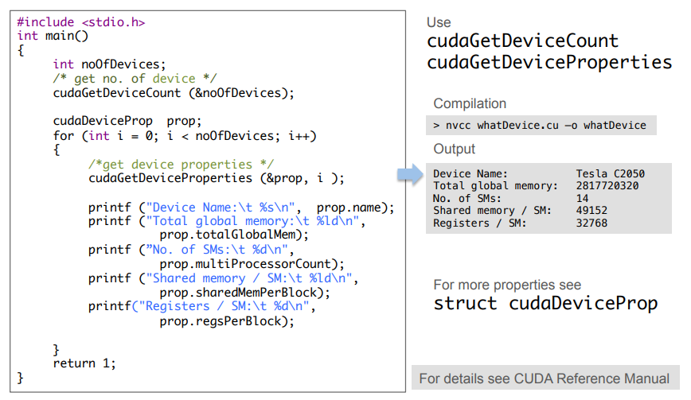
CUDA: Which GPU do I have ?

Slide 66
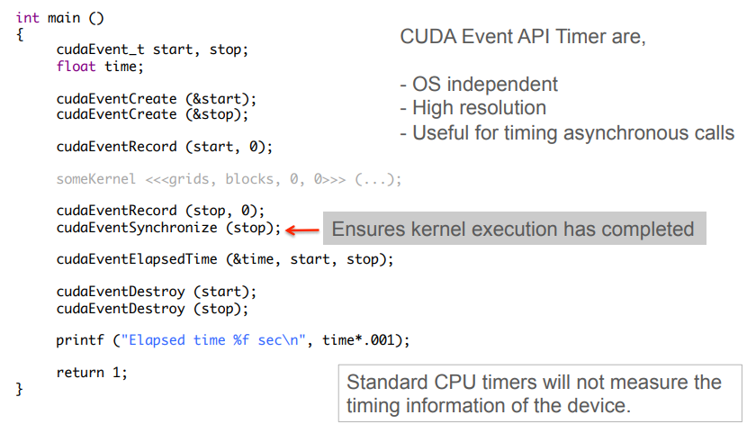
CUDA: “Timing with CUDA Event API»

Slide 67
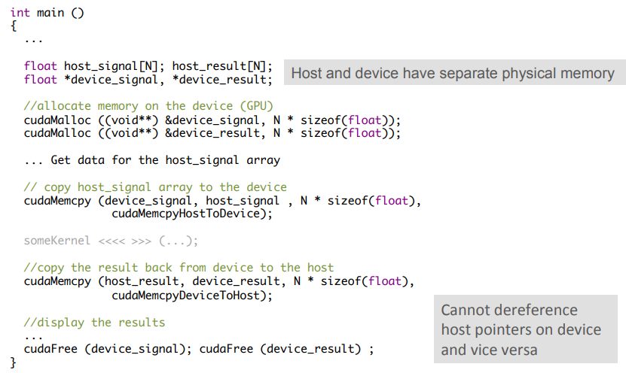
CUDA: “Memory Allocations / Copies»

Slide 68
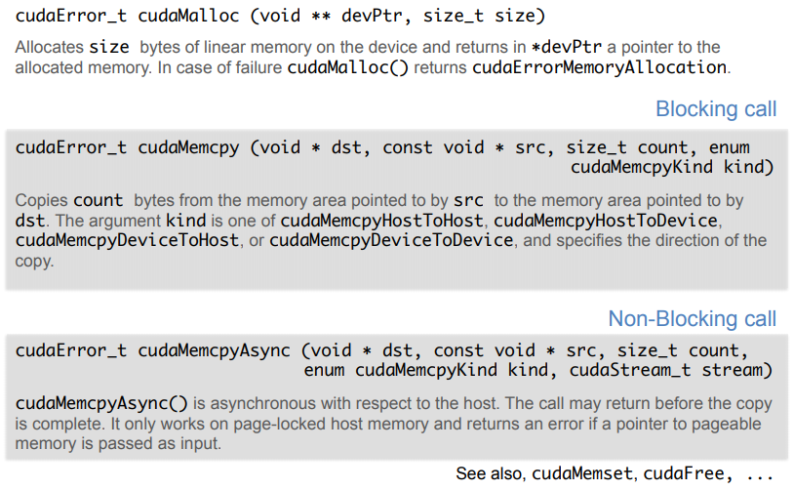
CUDA: “Basic Memory Methods»

Slide 69
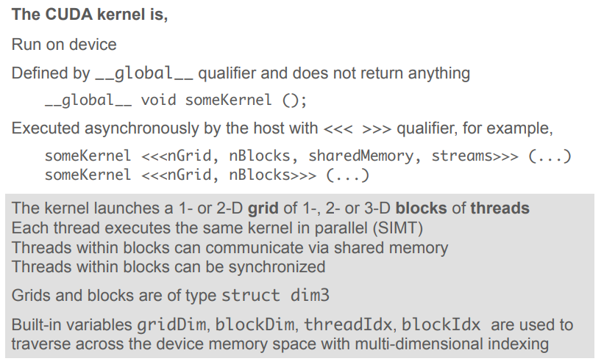
CUDA: “Kernel»

Slide 70
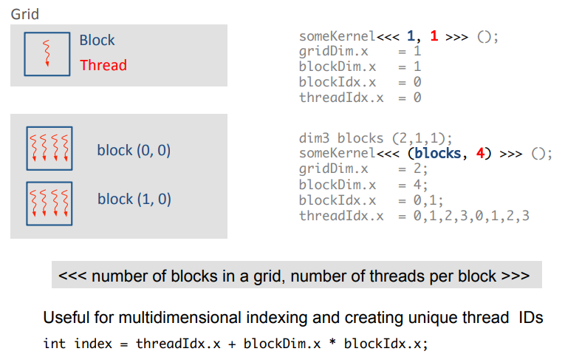
CUDA: “Grids, Blocks and Threads»

Slide 71
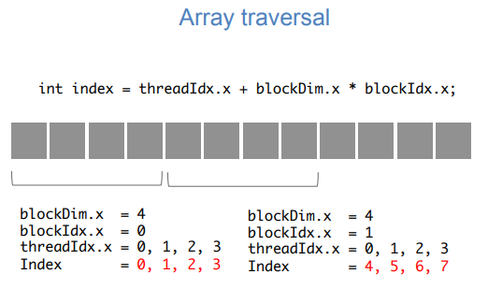
CUDA: “Thread Indices»

Slide 72
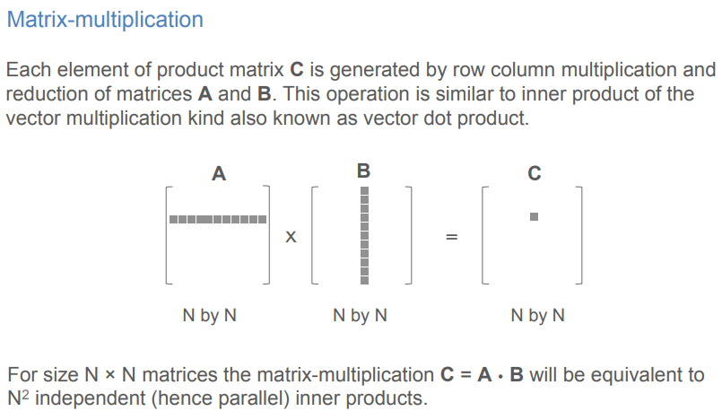
CUDA: “Matrix Multiplication»

Slide 73
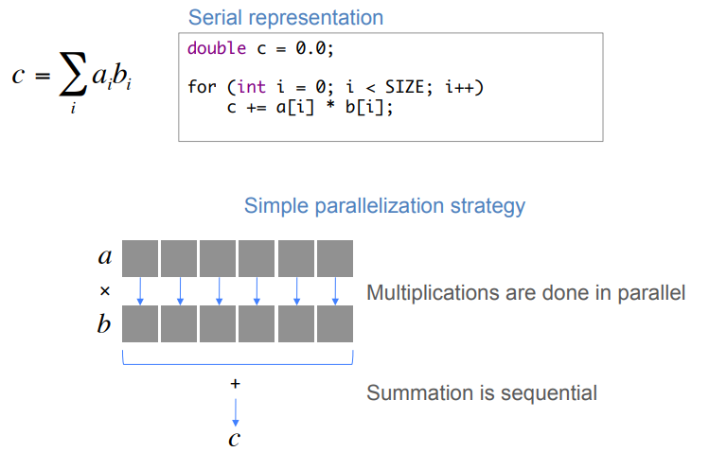
CUDA: “Matrix Multiplication»

Slide 74
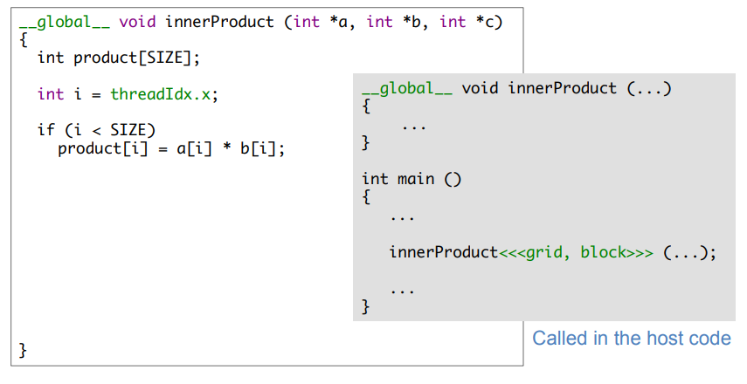
CUDA: “Matrix Multiplication»

Slide 75
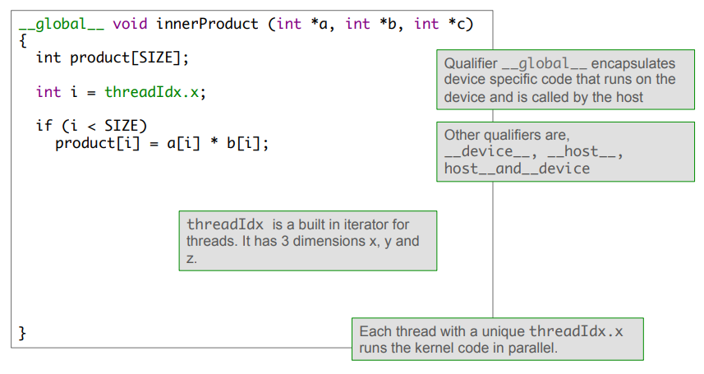
CUDA: “Matrix Multiplication»

Slide 76
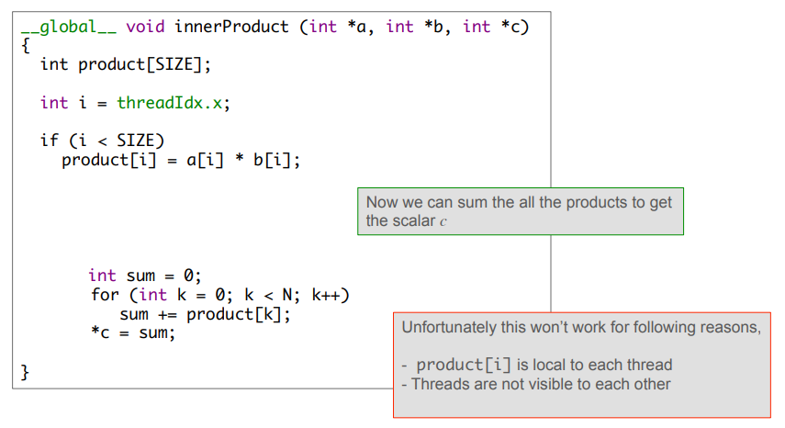
CUDA: “Matrix Multiplication»

Slide 77
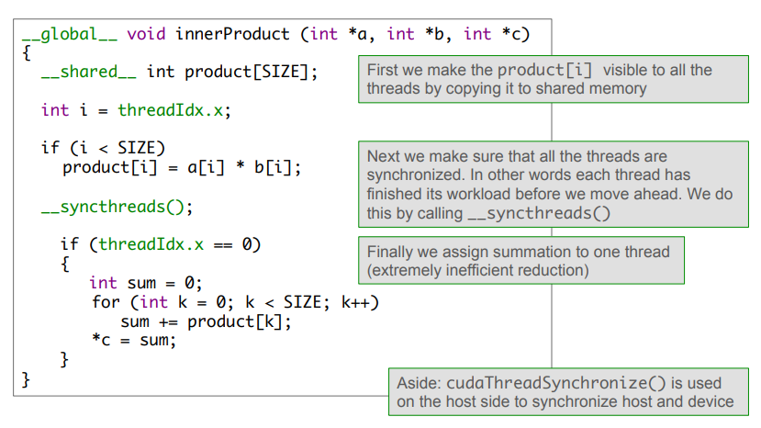
CUDA: “Matrix Multiplication»

Slide 78
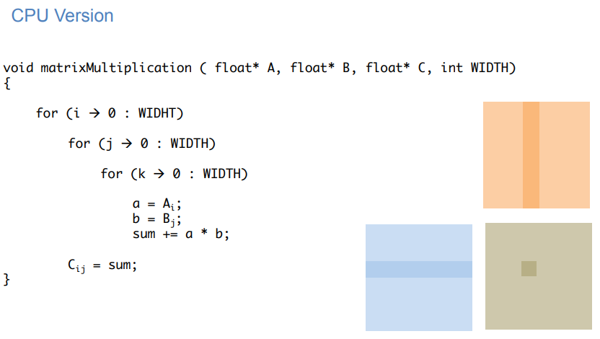
CUDA: “Matrix Multiplication»

Slide 79
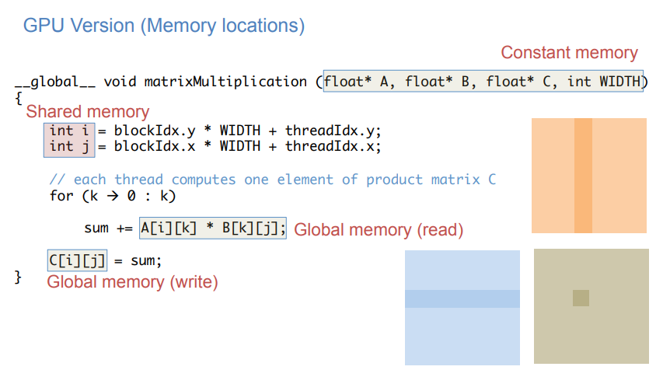
CUDA: “Matrix Multiplication»

Slide 80
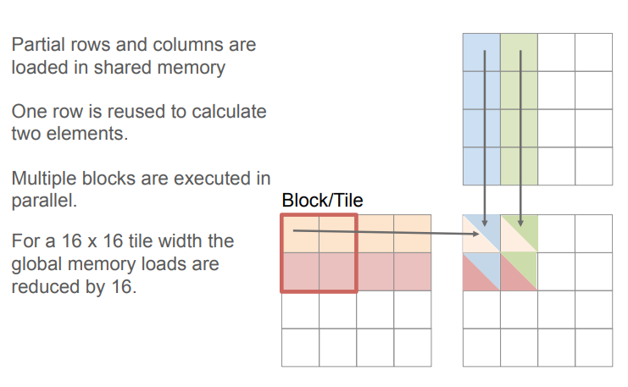
CUDA: “Matrix Multiplication»

Slide 81
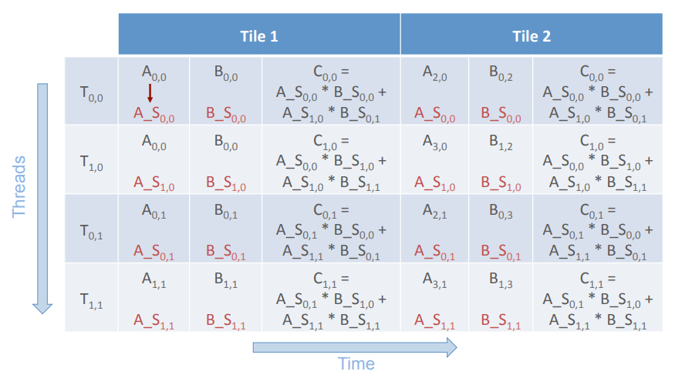
CUDA: “Matrix Multiplication»

Slide 82
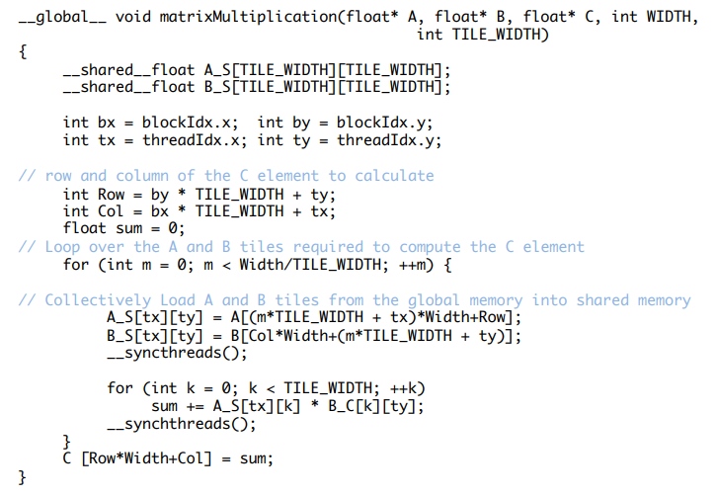
CUDA: “Matrix Multiplication»

Slide 83


Thank you for your attention !

